Slide 1
NATIONAL AIDS CONTROL COUNCIL
What do effective cascade-driven HIV programs look like
Dr Celestine Mugambi
National AIDS Control Council, Kenya
I AM TEAM KENYA

Slide 2
We are Team Kenya! Welcome to our Symposia;
#KENYAatAIDS2018
Date: Monday, July 23, 2018
Time: 10:15-12:15pm
Venue: Elicium I
Ending the AIDS epidemic and Achieving Universal Health Coverage by 2030 in Africa
Date: Tuesday, July 24, 2018
Time: 18:30-20:30
Venue: E105-108
Kenya: Leadership and Innovation for Results in eMTCT and Adolescent Care
Date: Wednesday, July 25, 2018
Time: 7:00-8:30am
Venue: E105-108
Youth Leadership in Action: Lessons from Kenya and Beyond
Date: Thursday, July 26, 2018
Time: 7:00-8:30am
Venue: E105-108
The Elusive 90:90:90: The Experience of Kenya as an Early Adopter of Evidence
Date: Friday, July 27, 2018
Time: 7:00-8:30am
Venue: G104-105
From Research to Real world settings; scaling up PrEP within National Programs.

Slide 3
HIV Burden in Kenya, 2018
#KENYAatAIDS2018
#KENYAatAIDS2018
HIV Prevalence = 4.9%
Female = 6.2% ; Male = 3.5%
PLHIV (all ages) = 1.5M
Adults living with HIV (15+)
= 1,388,200
Children living with HIV (0-14)
= 105,200
Number of new HIV Infections in 2017
Adolescent and Young People
Adolescents 10-19 years
All ages = 52,800
PLHIV = 105,200
New infections = 8,200
Adults (15+ = 44,800)
Young Adults 15-24 years
PLHIV = 184,700
New infections = 17,700
Children (0-14) = 8,000

Slide 4
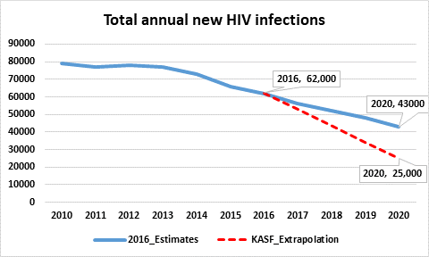
HIV infections trends
#KENYAatAIDS2018

Slide 5
Access to Treatment (90–90–90 Targets) for Kenya
#KENYAatAIDS2018
Estimated PLHIV 100%
1st 90
1.3M (90%)
90% of those who are HIV positive identified
90% of those identified are on ART
90% of those on ART are virally suppressed

Slide 6
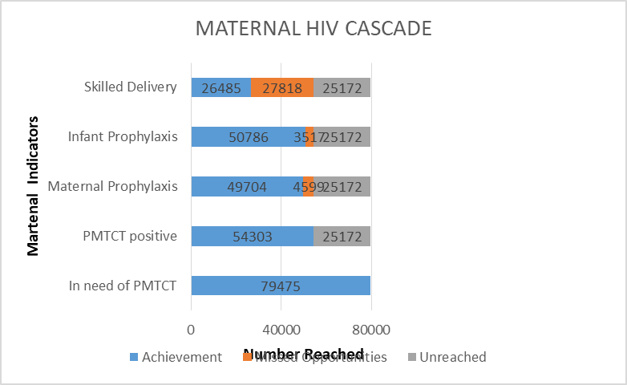
EMTCT Cascade
#KENYAatAIDS2018

Slide 7
What are the issues in HIV prevention?
#KENYAatAIDS2018
Prevention programmes not sufficiently scaled up because:
Lack of leadership, investments and accountability
Reluctance to address sensitive issues
Lack of systematic implementation
Reluctance to leverage non-health systems and sectors
One size fits all approach….

Slide 8
Why do we need prevention cascades?
#KENYAatAIDS2018
Standard targets to work towards that allow identification of policy, strategy and programme gaps
Interest policy makers
Spur technical action and accountability
-service delivery level
Advocacy
Resource mobilization

Slide 9
What are the opportunities?
#KENYAatAIDS2018
Global Prevention Roadmap
Has standard targets and outputs
Prioritized interventions and populations
Political commitments of the Global Coalition

Slide 10
HIV Prevention Cascades :
In which cascades do we invest in?
#KENYAatAIDS2018
Population based cascades
Who is at risk?
Where are they?
Different populations need different things- multiple cascades? Which ones do we prioritize?
Intervention based cascades
What intervention is required by who?
Intervention specific cascades or package based cascades?
Targets (available data systems)
Accountability for monitoring and reporting

Slide 11
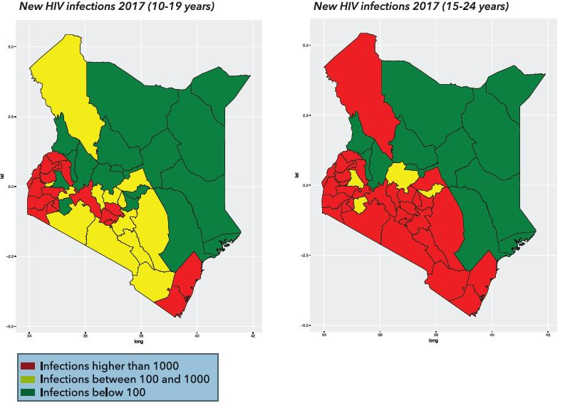
Who is at risk? AYP………
#KENYAatAIDS2018
Characterization of most at risk?
Prioritization of populations, programmes, products for whom cascades is necessary must be contextualized and based on local (county) epidemics

Slide 12
Population Based Cascade-AGYW (Theoretical)
#KENYAatAIDS2018
Source: The Global Fund

Slide 13
Population Based Cascade-AGYW
(Theoretical)
#KENYAatAIDS2018
Source: The Global Fund

Slide 14
Prioritization by population and product (intervention) based on local epidemics
#KENYAatAIDS2018
Condoms Prevention Cascade(s)? for Sex Workers in Nairobi
- In-sufficient data for many cascades
- How do we model/ estimate the prevention benefit

Slide 15
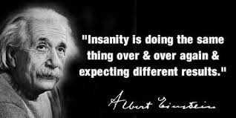
Cascades will be as useful as they can revolutionize execution of HIV programming
#KENYAatAIDS2018
Forecasting and quantification systems and expertise
What product is required, where?
How many products (by count)
Commodity supply and management systems
Promoting uptake
Targeted HIV prevention and product literacy
Investments in marketing prevention
‘Every young person, old person, literate or not knows where to get a ‘bamba 20’ in Kenya. Why do they not know where to get a condom?’

Slide 16
Cascades will be as useful data systems
#KENYAatAIDS2018
Monitoring and evaluation
Targets & indicators for HIV prevention
Key (global or national) indicators for the prevention cascade e.g. Tx 90-90-90
Data collection tools and systems
Reporting uptake
Community follow up
Adherence
Data capture and use at national level and utilization

Slide 17
Final considerations
#KENYAatAIDS2018
Investments in cascades should cause minimal interruption to already existing health and other sector data systems
Non health programs-can these be used as a platform for HIV prevention delivery? Cascades must consider data from other systems e.g. education or social services that are available in many countries?
Perhaps, there will not be a single cascade, but multiple cascades
Kenya – condoms cascade as a pilot at scale

Slide 18
Dr
Acknowledgements
#KENYAatAIDS2018
NACC Colleagues –
Nduku Kilonzo, Emmy Chesire, Kennedy Mutai, Joab Khasewa ,Becky Nyambeki, George Onyango
NASCOP Colleagues- George Githuka, Joyce Wamicwe
Lize Aloo- GFTAM,Geneva
Kenya HIV Prevention Working Group
Condom working group Kenya

